Slide 1
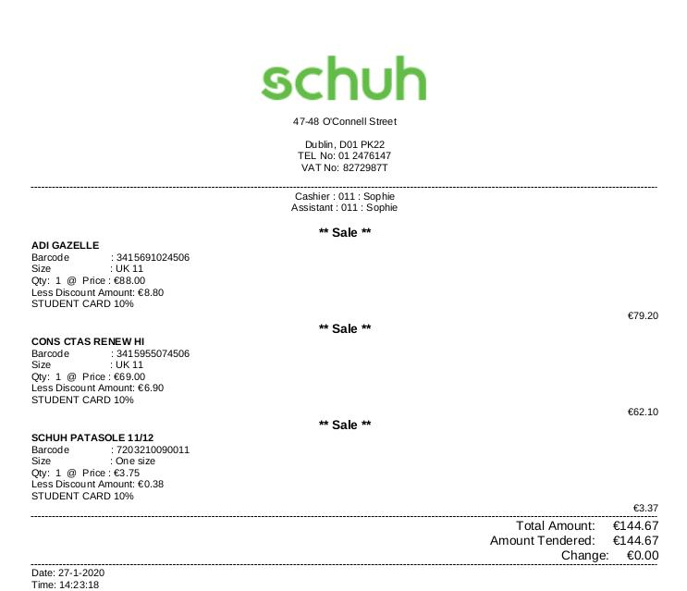
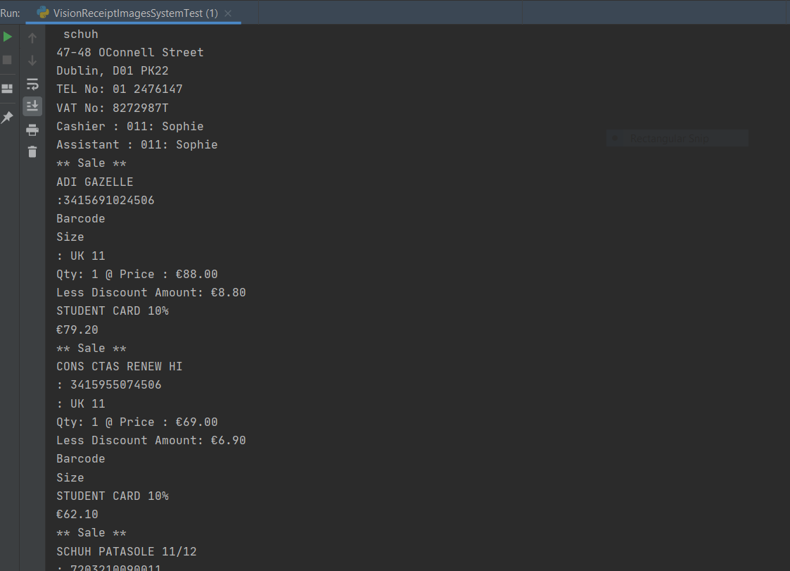
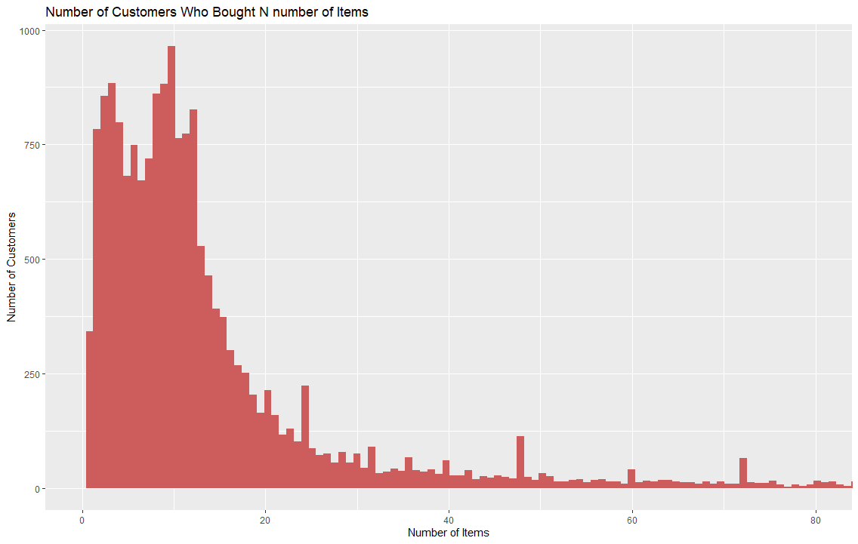
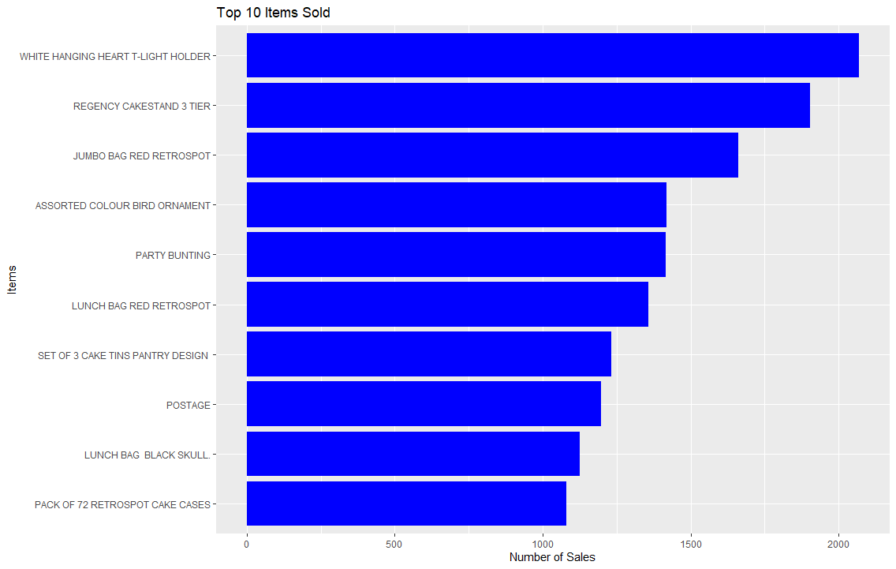






David Sheehy BSc. (Honours) Computing
Data-Aid
This project will aim to analyze a users spending data using Association Rules Unsupervised Topic Modelling Techniques
Abstract:
This project is aimed to be a tool to analyze transaction data. This includes:
Computer Vision on to extract text and numeric data from image receipts
Association Rule Mining Using the Apriori Algorithm
Topic Modelling of Line Items Using Unsupervised Learning Algorithms on the Text Data;
Sample Of Results
Technologies Used

